Slide 1


HTML 5
WebSocket

Slide 2

WebSocket
Course objectives
By completing this course, you will be able to:
Explain the different way to do real-time before WebSocket
Explain how are the advantages of WebSockets
Create a WebSocket client

Slide 3


WebSocket
Course topics
Course’s plan:
Introduction
And WebSocket was
WebSocket interface

Slide 4
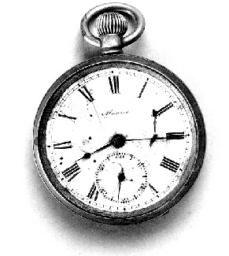
Introduction
WebSocket

Slide 5
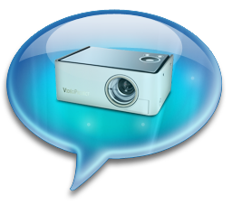
Introduction
Presentation
Normally when a browser visits a web page
An HTTP request is sent to the web server
The web server acknowledges this request and sends back the response
In many cases, the response could be stale by the time the browser renders the page…

Slide 6
Introduction
Presentation
To get the most up-to-date "real-time" information without refreshing manually, you can use:
Polling
Long-polling
Streaming
And since recently, WebSockets !

Slide 7
Introduction
Polling
Ajax client
Server
Update
request
response
request
response
Update
With polling, the browser sends HTTP requests at regular intervals and immediately receives a response

Slide 8
Introduction
Long-Polling
Ajax client
Server
request
response
Update
request
response
Update
With long-polling, the browser sends a request to the server and the server keeps the request open for a set period

Slide 9
Introduction
Streaming
Ajax client
Server
request
response
Update
response
Update
With streaming, the browser sends a complete request, but the server maintains an open response that is continuously updated

Slide 10
Introduction
Benefits & Drawbacks
 | Benefits | Drawbacks
Polling | Good solution if the exact interval of message delivery is known | Many connections are opened and closed needlessly
Long-polling | Receive message updates immediately after they are delivered | Hold requests increases server load
Streaming | No need to send several requests | Hold requests and increases server load and browsers need to close and reconnect the channel to release memory
A common drawback of the three solutions, is that they use the HTTP protocol

Slide 11


Questions ?

Slide 12
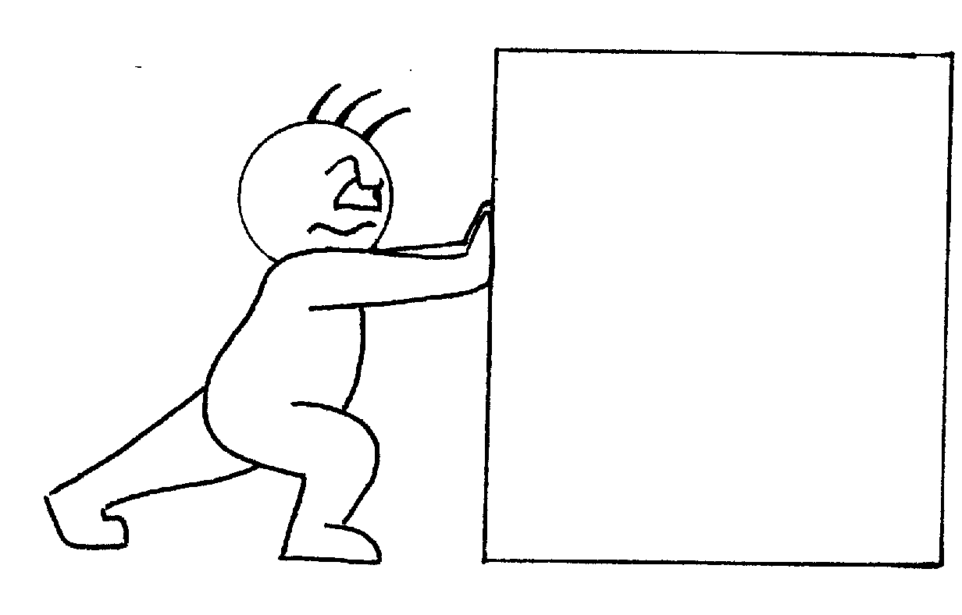
And web socket WAS
WebSocket

Slide 13
And WebSocket was
Presentation
Web Sockets represents the next evolution of web communications
Bidirectional communications channel
Through a single socket over the Web
To establish a connection
HTTP protocol is upgraded to the WebSocket protocol

Slide 14
And WebSocket was
Working
Browser
Server
WebSocket Upgrade
Update
WebSocket Frame
Update
WebSocket Frame
Update
WebSocket Frame

Slide 15
And WebSocket was
Handshake
The WebSocket handshake:
GET /text HTTP/1.1\r\n
Upgrade: WebSocket\r\n
Connection: Upgrade\r\n
Host: www.websocket.org\r\n
...\r\n
request
HTTP/1.1 101 WebSocket Protocol Handshake\r\n
Upgrade: WebSocket\r\n
Connection: Upgrade\r\n
...\r\n
response
Notes:
The first

Slide 16
And WebSocket was
Network usage
Network throughput overhead of the polling:
Number of clients polling every second | Estimated network throughput
1000 | 6.6 Mbps
10 000 | 66 Mbps
100 000 | 665 Mbps

Slide 17
And WebSocket was
Network usage
Network throughput overhead of WebSocket:
Number of clients receiving 1 message/second | Estimated network throughput
1000 | 0.015 Mbps
10 000 | 0.153 Mbps
100 000 | 1.526 Mbps

Slide 18
Questions ?

Slide 19

WebSocket interface
HTML5 - New APIs

Slide 20
WebSocket interface
Constructor
The WebSocket interface propose the following constructor :
WebSocket(url, protocol)
url specifies the URL to which to connect
protocol specifies a sub-protocol that the server must support for the connection (optional)

Slide 21
WebSocket interface
Attribute
The readyState interface attribute represents the state of the connection
Can have the following values :
CONNECTING (numeric value 0)
OPEN (numeric value 1)
CLOSED (numeric value 2)

Slide 22
WebSocket interface
Method
The send(data) method allows you to transmit data using the connection
If the readyState attribute is CONNECTING,
An INVALID_STATE_ERR exception is raised

Slide 23
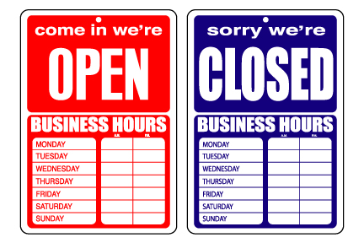
WebSocket interface
Event handlers
The interface provide four event handlers :
onopen
onmessage
onclose
onerror

Slide 24
WebSocket interface
Example
var WS_URL = "ws://www.host.com/socket"
, websocket = new WebSocket(WS_URL, "echo-protocol");
websocket.onopen = function(evt) {
websocket.send("Hello Socket!");
}
websocket.onmessage = function(evt) {
console.log("Socket says: " + evt.data);
}
websocket.onclose = function(evt) {
console.log("You are disconnected from the socket.");
}

Slide 25
Questions ?

Slide 26
WebSock
WebSocket server
A lot of libraries are available to implement WebSocket servers
We’ll see how to develop a WebSocket server with Node.js in a next chapter…

Slide 27


